Slide 1
System Modeling in Software Engineering
Presented by: Team Prefetch

Slide 2



Dr. Md. Zulfiker Mahmud
Course Instructor
Associate Professor,
Dept. of CSE, JnU
Nishat Mahmud
Md. Waliul Islam Rayhan
B190305003
B190305034
Software Engineering Lab Course Code: CSEL-3206

Slide 3
Software Models
01
Context Model
02
Interaction Model
03
Structural Model
04
Behavioral Model

Slide 4
Connecting Users to Systems: Language in System Modeling
User Requirement
System Requirement
Natural Language
Technical Language
System modeling starts with what users want in simple terms, which is then translated into technical language to design and represent the system systematically.

Slide 5
System Modeling
System modeling is the process of developing abstract models of a system, with each model presenting a different view or perspective of that system.
System modeling can be approached through two main perspectives:
System Perspective
UML Diagram Types

Slide 6
System Perspective
A Context or An External Perspective
Model of the context or environment of the system.
An Interaction Perspective
Model the interactions between a system and its environment, or between the components of a system.
A Structural Perspective
Model the organization of a system or the structure of the data that is processed by the system.
A Behavioral Perspective
Model the dynamic behavior of the system and how it responds to events.

Slide 7
UML (Unified Modeling Language) Diagram Types
Activity Diagram
Which show the activities involved in a process or in data processing.
Use-Case Diagram
Which show the interactions between a system and its environment.
Sequence Diagram
Which show interactions between actors and the system and between system components.
Class Diagram
Which show the object classes in the system and the associations between these classes.
State Diagram
Which show how the system reacts to internal and external events.

Slide 8
01
Context Model

Slide 9
Context Model
A context model shows what's around a system, helping us understand its boundaries and connections with the outside world.
Context models visually represent a system's external environment, aiding in defining its boundaries and interactions.
These models are crucial for understanding the operational context and influences that shape system design decisions.

Slide 10
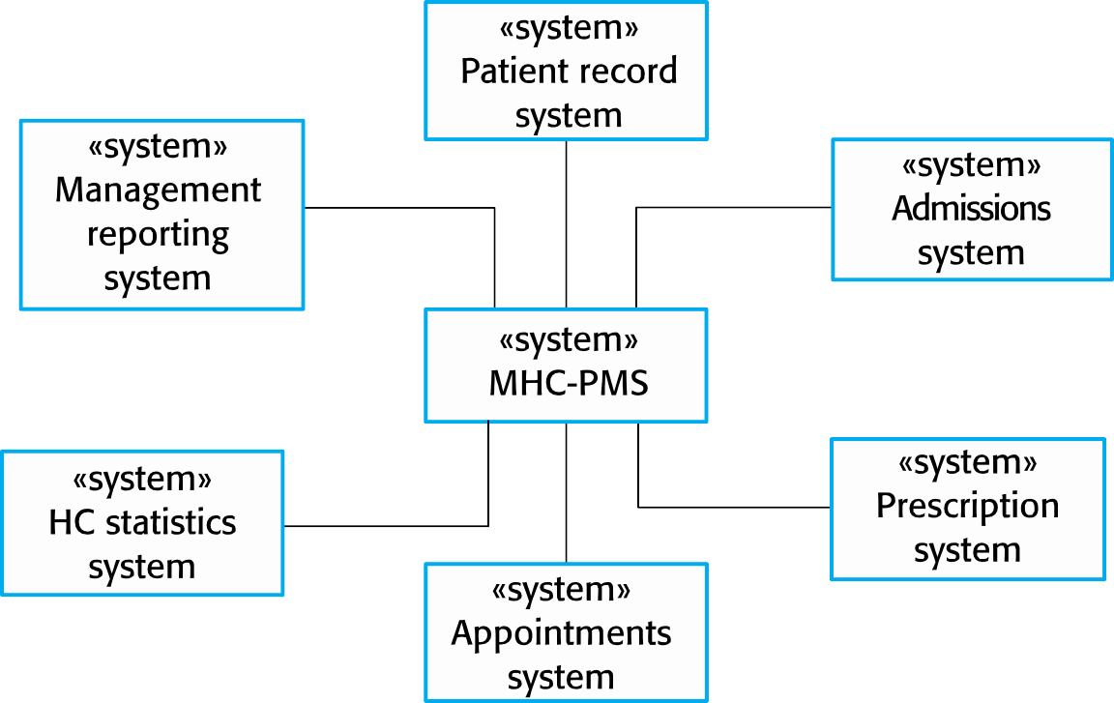
The Context of the MHC-PMS
Mental Health Care – Patient Management System

Slide 11
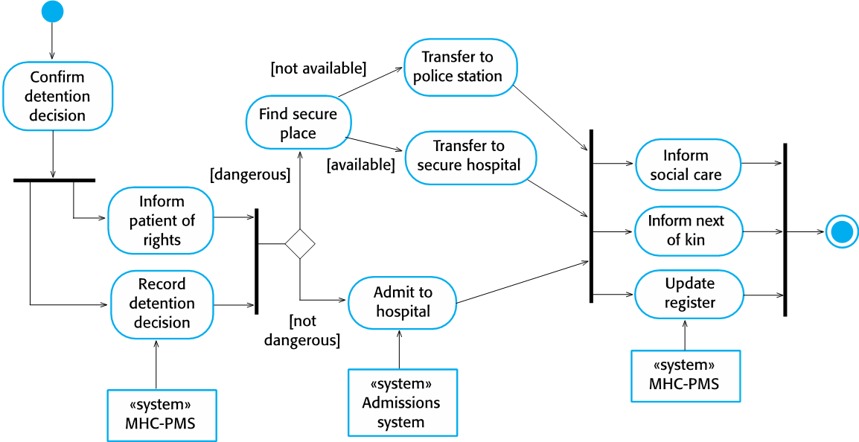
Activity Diagram: Process Model of Involuntary Detention

Slide 12
02
Interaction Model

Slide 13
Interaction Model
An interaction model illustrates how different parts of a system work together, showing the flow of communication and actions between them.
Interaction models can be represented in two ways:
Use case modeling, commonly employed for interactions between a system and external actors (users or other systems)
Sequence diagrams, used to model interactions between system components, with the option to include external agents.

Slide 14

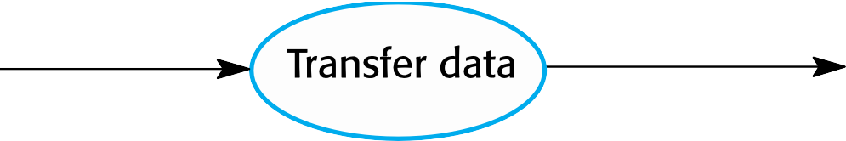

Transfer Data Use Case
A use case in the Mental Health Care – Patient Management Systems
Medical Receptionist
Patient Record System

Slide 15
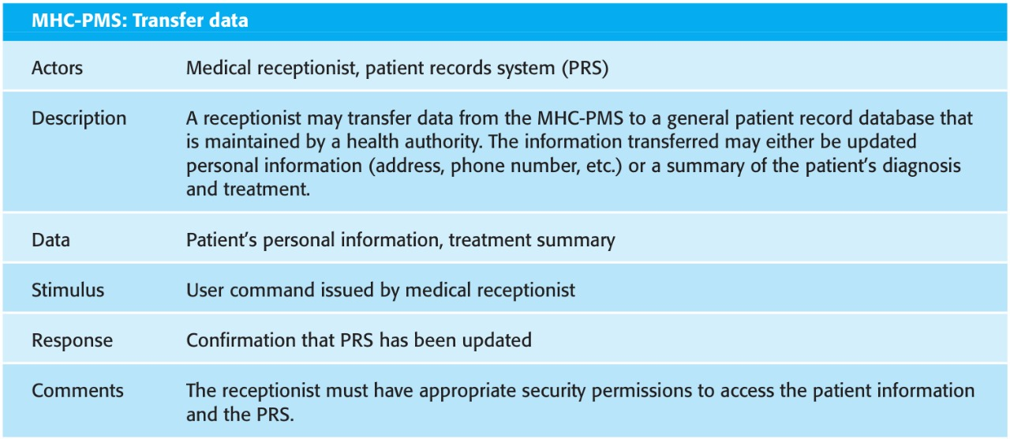
Tabular Description of the ‘Transfer data’ Use-case

Slide 16
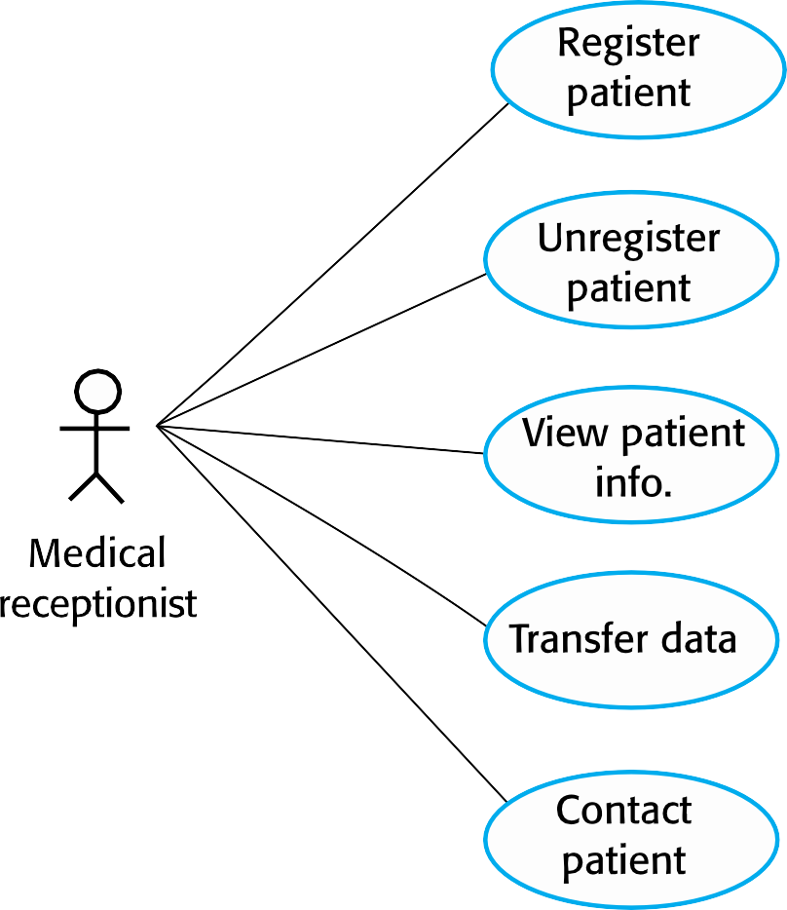
Use cases in the MHC-PMS involving the role ‘Medical Receptionist’

Slide 17









Sequence Diagram for View Patient Information

Slide 18
03
Structural Model

Slide 19
Structural Model
A structural model shows how the different parts of a system are organized and how they relate to each other, providing a blueprint of the system's architecture.
A class diagram is a common representation in system modeling that is used to depict the structural aspects of a system, including classes, their attributes, and relationships between them.

Slide 20

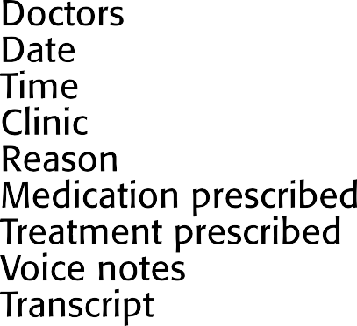
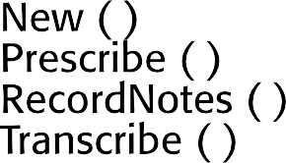
The Consultation Class
Class Name
Attributes
Methods

Slide 21


UML Classes and Association

Slide 22
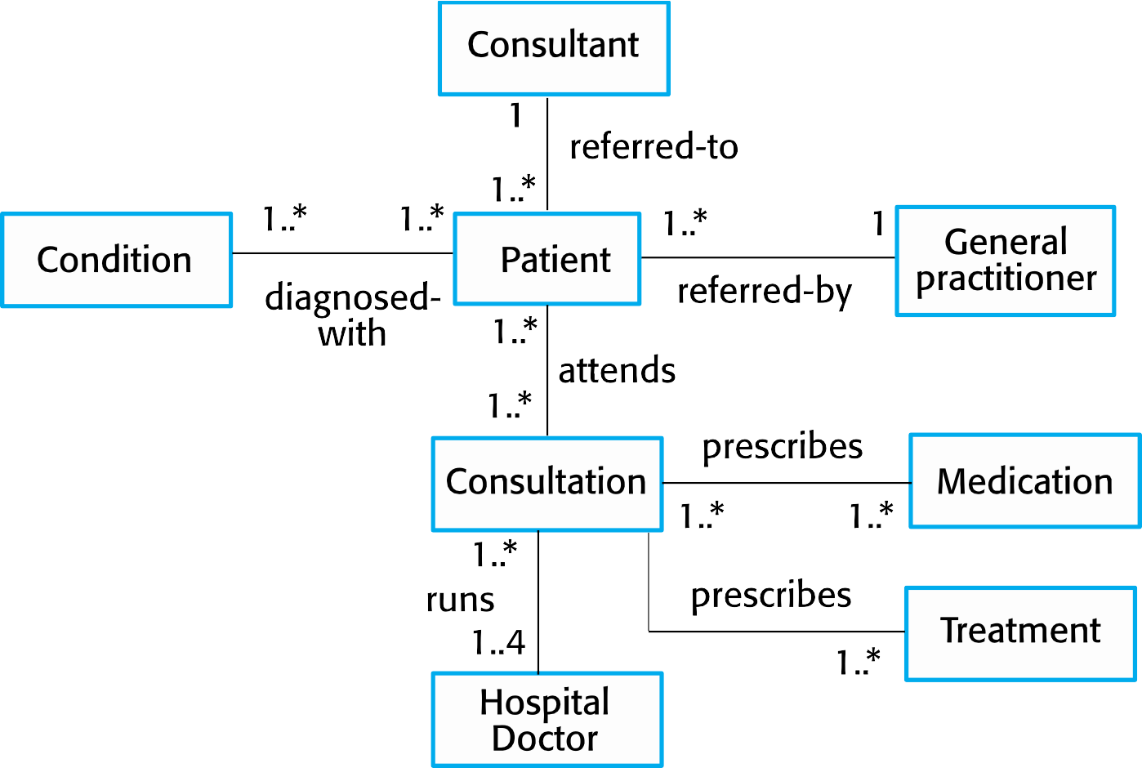
Classes and Associations in the MHC-PMS

Slide 23
Generalization
Generalization is an everyday technique that we use to manage complexity.
In a generalization, the attributes and operations associated with higher-level classes are also associated with the lower-level classes.

Slide 24

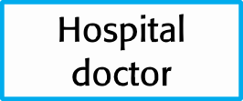
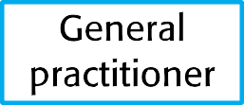


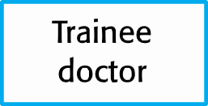
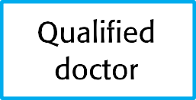
A Generalization Hierarchy (Inheritance)
Parent Class
Parent Class
Child Class
Child Class

Slide 25
04
Behavioral Model

Slide 26
Behavioral Model
Behavioral models are models of the dynamic behavior of a system as it is executing.
They show what happens or what is supposed to happen when a system responds to a stimulus from its environment.
We can think of these stimuli as being of two types:
Data: Some data arrives that has to be processed by the system.
Events: Some event happens that triggers system processing. Events may have associated data but this is not always the case.

Slide 27
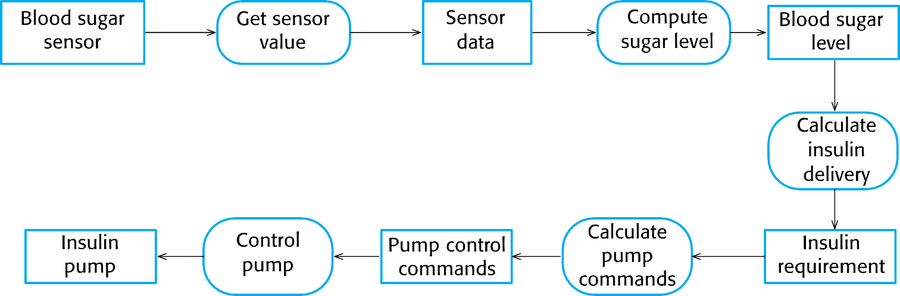
An Activity Model of the Insulin Pump’s Operation

Slide 28
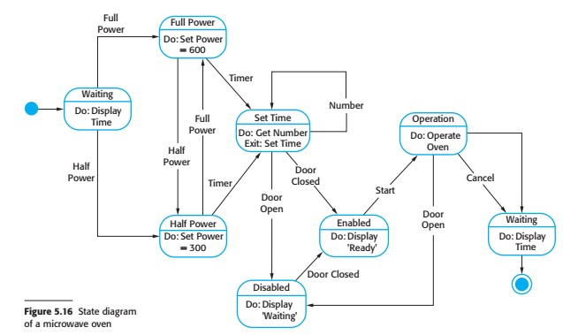
UML State Transition Diagram

Slide 29
Thanks!

